Slide 1

JavaScript
CAP 5738 Data Visualization
Spring 2018
Dr. Sayeed S. Alam

Slide 2
What is JavaScript?
JavaScript was introduced in 1995 as a way to add programs to web pages in the Netscape Navigator browser.
The language has since been adopted by all other major graphical web browsers
JavaScript has almost nothing to do with the programming language named Java.
When JavaScript was being introduced, the Java language was being heavily marketed and was gaining popularity.

Slide 3
DOM and BOM
The DOM is the Document Object Model, which deals with the document, the HTML elements themselves, e.g. document and all traversal you would do in it, events, etc.
The BOM is the Browser Object Model, which deals with browser components aside from the document, like history, location, navigator and screen (as well as some others that vary by browser).

Slide 4
First JavaScript program
<button onClick='myFunct()'>Click</button>
<script>
function myFunct()
{
window.alert('Hello');
}
</script>

Slide 5
Modifying HTML using document
<div id='print-container'>
</div>
<script>
function print(msg) {
var div = document.getElementById('print-container');
div.innerHTML+=msg;
}
print(‘hello’);
</script>

Slide 6
Values in JavaScirpt
Every value has a type that determines its role.
There are six basic types of values in JavaScript: numbers, strings, Booleans, objects, functions, and undefined values.
var val = false; // boolean value
var num = 13; //int value

Slide 7
Numbers in JavaScript
Two types: Integers and Floats
var val1 = 123; // integer
var val2 = 123.23; // float
var val3 = 123.34e8; // float with exponents
Numbers : 64 bit
52 bit magnitude, 11 bit exponent, 1 bit sign (for float)
54 bits for integer. (53 value, 1 bit sign)
Max Integer : 2^53 -1

Slide 8
Arithmetic
Operators: +,-, *, /, %
Example:
100 + 4 * 11
144 % 12

Slide 9
Special Numbers
∞ = Infinity
NaN = Not a Number
0/0 = NaN

Slide 10
Strings
" Patch my boat with c h e w i n g gum "
' Monkeys wave goodbye ‘
Both double quote or single quote
" This is the first line \ nAnd this is the s e c o n d “
\n = escape character

Slide 11
Some more on Strings
‘She said “Hello”’
She said “Hello”
“She said ‘Hello’”
She said ‘Hello’
What if I use only double quote to print:
She said “Hello” ?
“She said \”Hello\””

Slide 12
Exercise
Print the following:
"Daenerys Stormborn of the House Targaryen, First of Her Name, the Unburnt, Queen of the Andals and the First Men, Khaleesi of the Great Grass Sea, Breaker of Chains, and Mother of Dragons.“
Use <span> tag for making text bold
CSS tag: font-weight : bold;

Slide 13
Unary Operators
Example:
TypeOf operator: Determines type of a value.
print(typeof 4.5)
print(typeof print)
Negation operator:
print(-(10-2))

Slide 14
Boolean Values and Logical Operators
Boolean values: true or false
Comparison operators:
==, <,>, <=, >=, !=
=== vs ==
== : Equal, Returns true if the operands are equal.
===: Strict equal, Returns true if the operands are equal and of the same type.
var val1=‘3’;
print(val1==3)
print(val1===3)

Slide 15
Ternary Operators
var val = <logic_test>?success_val ? fail_val;
var val1=‘Barry’;
var isBarry = val1===‘Barry’? 1:0;

Slide 16
Undefined
There are two special values, written null and undefined, that are used to denote the absence of a meaningful value. They are themselves values, but they carry no information.

Slide 17
Automatic Type Conversions
print(8 * null )
print("5" - 1)
print("5" + 1)
print(" five " * 2)
print( false == 0)
print( null == u n d e f i n e d ) ;
print( null == 0) ;

Slide 18
Short-circuiting Logical Operators
print( null || " user ")
// user
print(" Karl " || " user ")
// Karl

Slide 19
Expressions
A fragment of code that produces a value is called an expression.
Every value that is written literally (such as 22 or "psychoanalysis") is an expression.
val = (5+3) * 4;
5 = Value, 3 = Value, 5+3 = Expression, (5+3)*4 = Expression

Slide 20
Statements
Statement is an expression with a semicolon after it.
Statements are similar to sentences in the English language. A sentence forms a complete idea which can include one or more clauses. Likewise, a statement in JavaScript forms a complete command to be executed and can include one or more expressions.
In some cases, JavaScript allows you to omit the semicolon at the end of a statement.
In other cases, it has to be there, or the next line will be treated as part of the same statement.
var val = 5
*3 ;
print(val);

Slide 21
Variables
To catch and hold values, JavaScript provides a thing called a variable.
The special word (keyword) var indicates that this sentence is going to define a variable.
It is followed by the name of the variable and, if we want to immediately give it a value, by an = operator and an expression.
var val = 3*5;

Slide 22
Variables
Variable names can be any word that isn’t a reserved word (such as var).
They may not include spaces.
Digits can also be part of variable names—catch22 is a valid name, for example—but the name must not start with a digit.
A variable name cannot include punctuation, except for the characters $ and _.
var $val_1 = 3*5;
var val;
print(val)

Slide 23
Keywords and reserved words
Words with a special meaning, such as var, are keywords, and they may not be used as variable names.
let this long package float, goto private class if short.
while protected with debugger case, continue volatile interface.
instanceof super synchronized throw, Extends final export throws.
try import double enum? - false, boolean, abstract function,
implements typeof transient break! void static, default do,
switch int native new. else, delete null public var
in return for const, true, char …finally catch byte.
https://stackoverflow.com/a/12114140/326684

Slide 24
Environment
The collection of variables and their values that exist at a given time is called the environment.
When a program starts up, this environment is not empty.
It always contains variables that are part of the language standard, and most of the time, it has variables that provide ways to interact with the surrounding system.
print(window.location);

Slide 25
Functions
A lot of the values provided in the default environment have the type function.
A function is a piece of program wrapped in a value.
Such values can be applied in order to run the wrapped program
window.alert ()
window.confirm()
window.prompt()
console.log()

Slide 26
Exercise
Write a JavaScript program which will prompt user with two values and will print the subtraction of those values.
var val1 = prompt("Enter val1:");
var val2 = prompt("Enter val2:");
print(val1+"-"+val2+"="+(val1-val2));

Slide 27
Alternative HTML input
var val1 = document.getElementById('input1').value;
Write a JavaScript program which will prompt user with two values and will print the subtraction of those values. Use HTML Input tags
Val1 : <input id='input1' type='text'/>

Slide 28

Exercise
Write a method to convert Fahrenheit to Celsius
public double convertToCelsius(double farenheit)
$\frac{c}{5}= \frac{f−32}{9}$

Slide 29
Maths
Fields : E, PI
Methods:
abs
atan
max,min
sqrt
pow
random
floor
ceil

Slide 30
Exercise
Tossing : Head or Tail?
Use: Math.random()

Slide 31
Exercise
Find ϴ
(33.1, 41.67)
ϴ
(9.89, 22.4)
(33.1, 22.4)

Slide 32
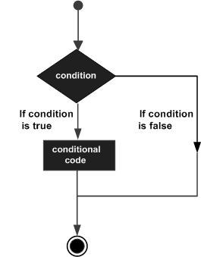
Decision Making

Slide 33
If statement
If (logic test)
{
//statements
}
else if(logic test#2)
{
//statements
}
else if() … …
else{
//statements
}

Slide 34
Exercise
Prompt a value and then show the value if it is a number.
Get the maximum among three variables.
IsLeapYear?

Slide 35
Switch-Case
switch(variable){
case val1:
//statement
Break
case val2:
//statement
default:
//statements

Slide 36
Exercise
PG1 -> Gold Garage
PG2 -> Blue
PG3-> Panther
PG4 -> Red
PG5 -> Market Station
PG6 -> Tech station
function getGarageName(garageNumber)

Slide 37
More Exercise
Write a JavaScript program to solve quadratic equations (use if, else if and else).
Prompt: a, b, and c.
$ax^{2}+bx+c=0$
$x= \frac{−b±\sqrt{b^{2}−4ac}}{2a}$

Slide 38
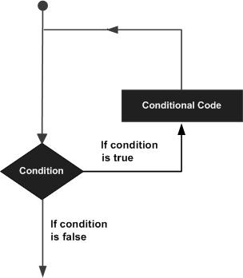
Loops

Slide 39
Loops
While loop
For loop
For in Loop ( Foreach)

Slide 40
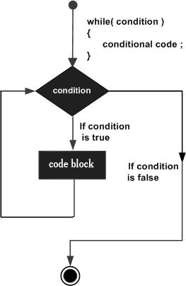
While Loops
while(Boolean_expression) {
// Statements
}

Slide 41
Exercise
Write a program which will print numbers up to a given count and also print the cumulative sum.
Count = 4
Output:
1 1
2 3
3 6
4 10

Slide 42
Exercise
What’s the output of the following program?
Var n = 1729;
Var sum = 0;
while (n > 0)
{
Var digit = n % 10;
sum = sum + digit;
n = n / 10;
}
Console.log(sum);

Slide 43
Infinite Loops
What’s the output?
var x =0;
while (x< 5)
{
x = 1;
x = x+1;
}
console.log(x);

Slide 44
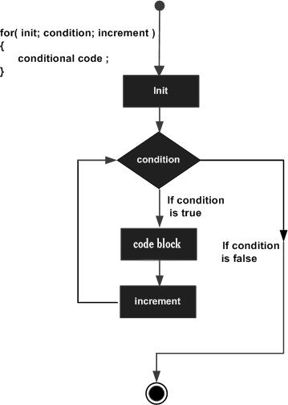
For-Loops
for(initialization; Boolean_expression; update) {
// Statements
}

Slide 45
For Loops Examples
Print : 1 to 100
for(var i=1;i<=100;i++)
{
console.log(i);
}
Print : 100 to 1
for(var i=100;i>=1; i--)
{
console.log(i);
}

Slide 46
Nested Loops
Sometimes, the body of a loop is again a loop. We say that the inner loop is nested inside an outer loop
Generate the triangular shape:
[]
[][]
[][][]
[][][][]
[][][][][]
[][][][][][]
[][][][][][][]

Slide 47
Star Pyramid
Print a pyramid with n rows.
N = 3
*
* *
* * *
HOW about an inverted pyramid ?

Slide 48
Break statement
A break statement can be used to exit a while , for , or do loop
var continueFlag = true;
while(true){
var input = prompt("Do you want to continue?");
continueFlag = input == "Y";
if(!continueFlag) break;
}

Slide 49
Continue Statements
A Continue statement jumps to the end of the current iteration of the loop.
for(var i=1;i<=10;i++)
{
if(i ==7)
{
continue;
}
console.log(i);
}

Slide 50
Exercise : Print Fibonacci Series
Write a method which will print first n numbers of a Fibonacci series.
Given n > 1
N = 7
Output: 1, 1, 2, 3, 5, 8, 13
Fib(0) = 0
Fib(1) = 1
Fib(n) = Fib(n-1) + Fib(n-2)

Slide 51
Arrays
JavaScript arrays are written with square brackets.
Array items are separated by commas.
The following code declares (creates) an array called cars, containing three items (car names):
var cars = ["Saab", "Volvo", "BMW"];
Array methods:
Pop, push, slice, indexof, sort

Slide 52
Objects
JavaScript objects are written with curly braces.
Object properties are written as name:value pairs, separated by commas.
var person = {firstName:"John", lastName:"Doe", age:50, eyeColor:"blue"};

Slide 53
Functions
The most common way to define a function in JavaScript is by using the function keyword, followed by a unique function name, a list of parameters (that might be empty), and a statement block surrounded by curly braces.
-
function functionname(parameter-list)
{
statements
}

Slide 54
Return statements
A JavaScript function can have an optional return statement. This is required if you want to return a value from a function. This statement should be the last statement in a function.
function concatenate(first, last)
{
var full;
full = first + last;
return full;
}

Slide 55
Nested Functions
function hypotenuse(a, b) {
function square(x) { return x*x; }
return Math.sqrt(square(a) + square(b));
}

Slide 56
Function Literals
function literals is another new way of defining functions. A function literal is an expression that defines an unnamed function.
var variablename = function(Argument List){
Function Body
};
var func = function(x,y){ return x*y };
function secondFunction(){
var result;
result = func(10,20);
document.write ( result );
}

Slide 57
More Topics
Date
RegExp
Events
DOM Manipulation
Jquery
Callbacks

Slide 58
References
https://www.tutorialspoint.com/javascript
https://www.w3schools.com/js
http://javascriptissexy.com/understand-javascript-callback-functions-and-use-them/

Slide 59
Thank You

